Slide 1
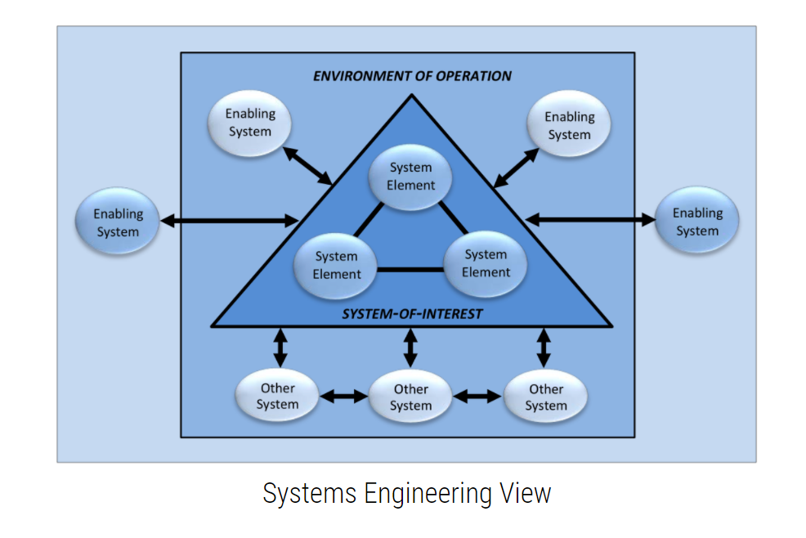
Systems Engineering View (example)

Slide 2
Spring Security – Update Default Strength for Password Encoders
Environment of Operation
Enabling System
Enabling System
System-of-Interest
System Element
System Element
Enabling System
Enabling System
Other System
Other System

